Slide 1


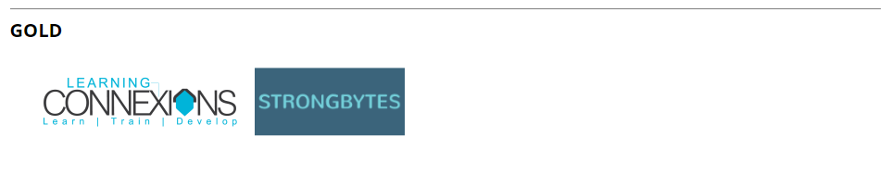




Slide 2
master your debugger;
using Google Chrome
Paul Comanici

Slide 3
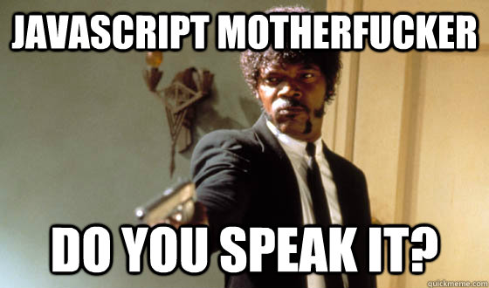
About me

Slide 4
Topics
Elements
Console
Network
Sources

Slide 5
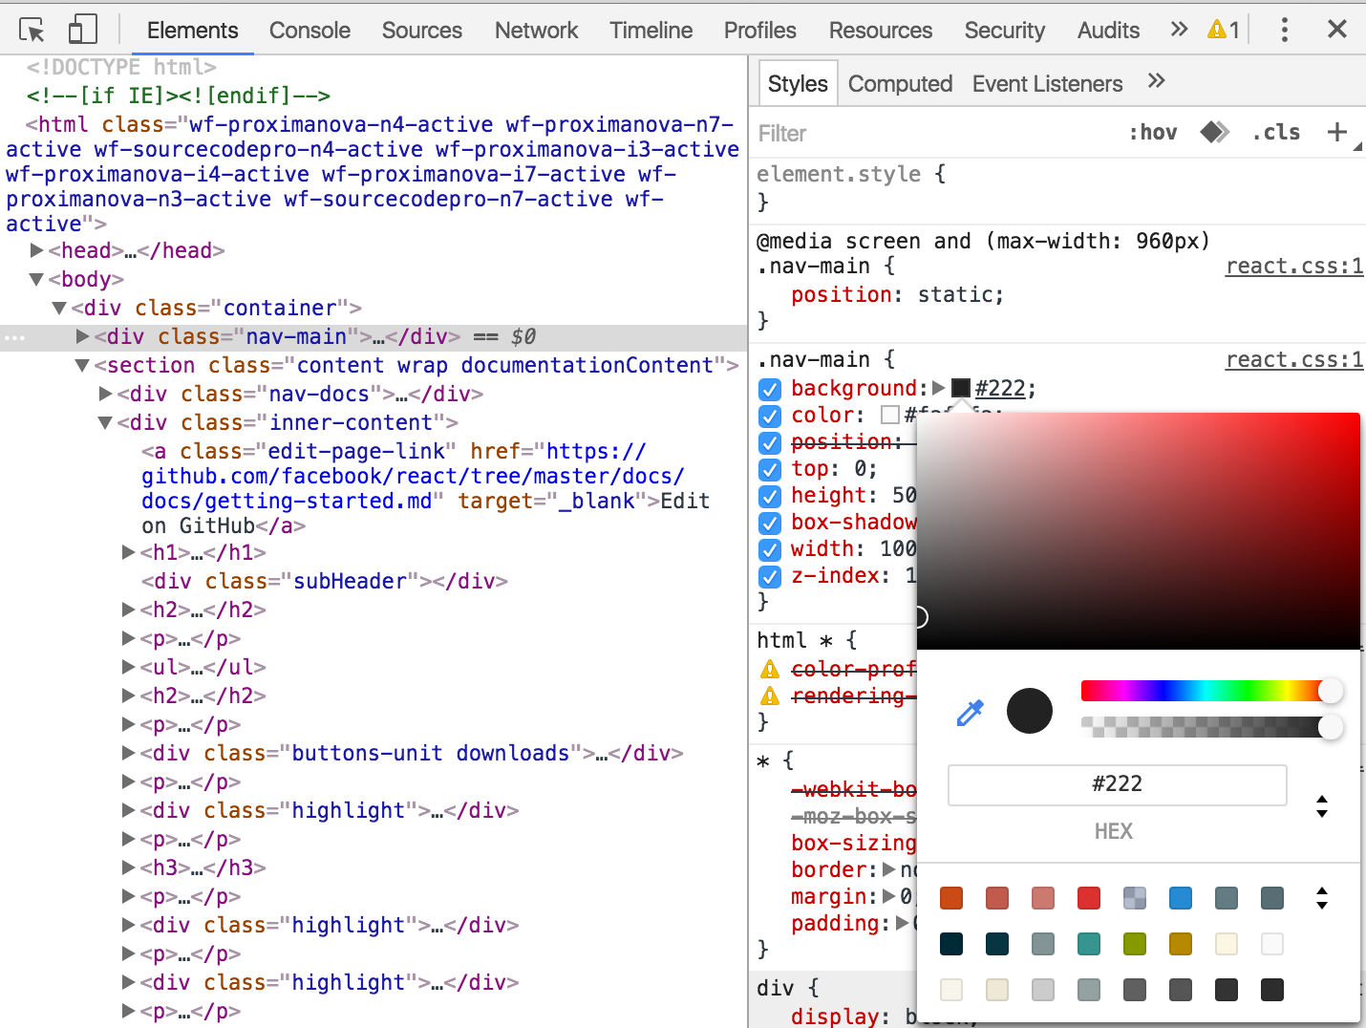
Elements

Slide 6
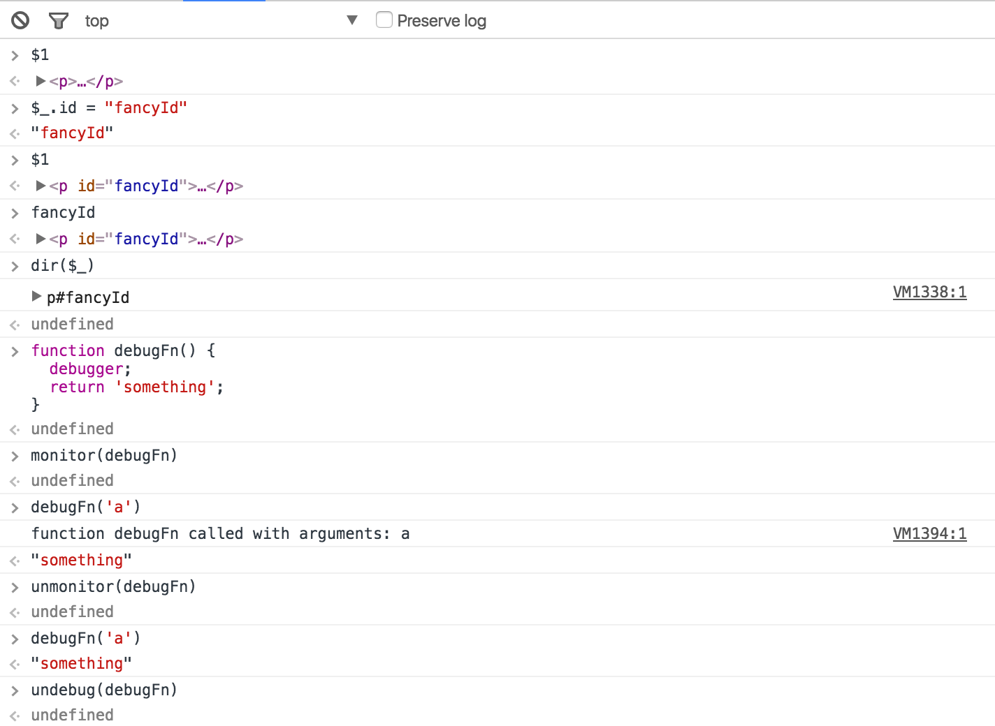
Console

Slide 7
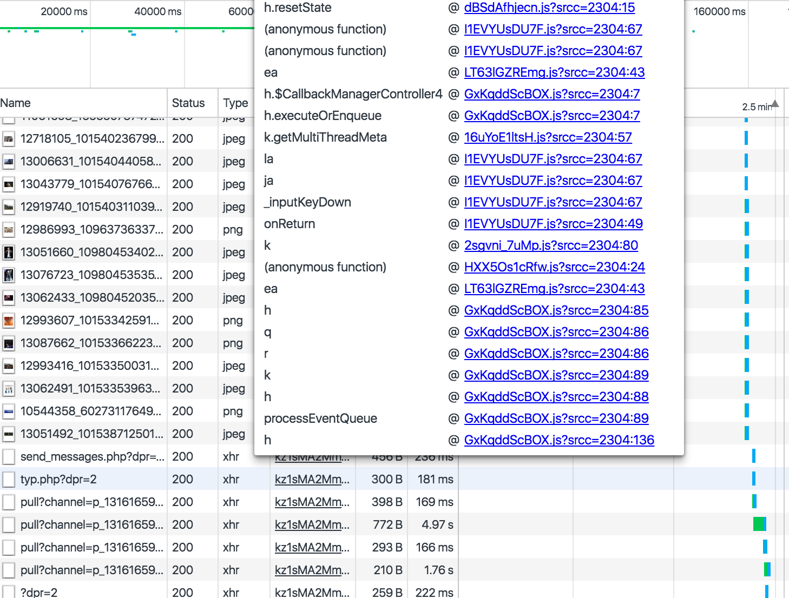
Network

Slide 8
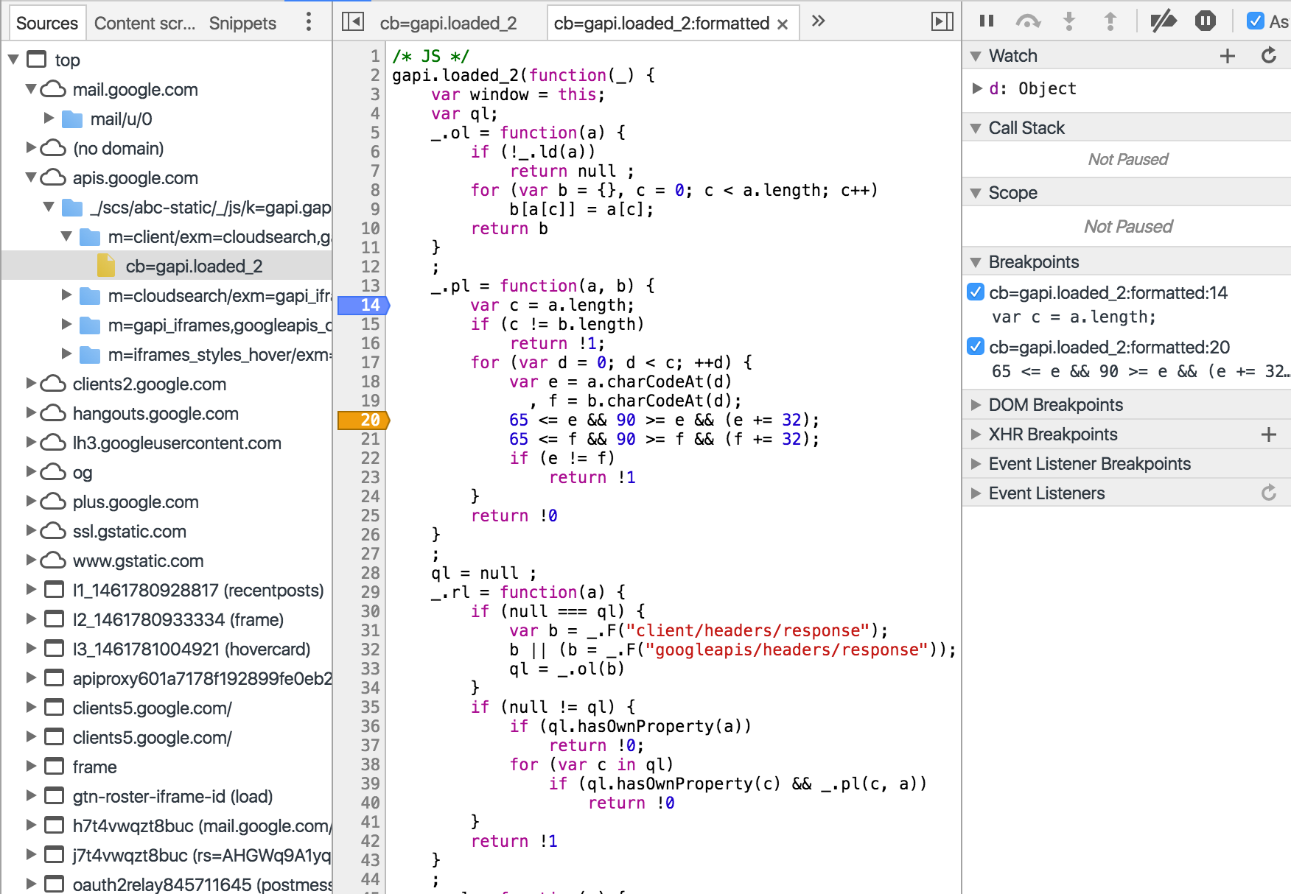
Sources

Slide 9
Resources
https://developers.google.com/web/tools/chrome-devtools/
https://www.youtube.com/user/ChromeDevelopers
https://chrome.google.com/webstore/detail/angularjs-batarang/ighdmehidhipcmcojjgiloacoafjmpfk
https://chrome.google.com/webstore/detail/react-developer-tools/fmkadmapgofadopljbjfkapdkoienihi

Slide 10
Thanks
“Learning is hard work, but everything you learn is yours and will make subsequent learning easier.”
-- Marijn Haverbeke, Eloquent JavaScript: A Modern Introduction to Programming

